Slide 1





Improved prediction of disease-associated SNPs in GWA data by Bayesian modeling and data integration
Johannes Söding
Quantitative and Computional Biology
MPI for Biophysical Chemistry, Göttingen
October 27th, 2015
e:Med Meeting 2015 on Systems Medicine

Slide 2
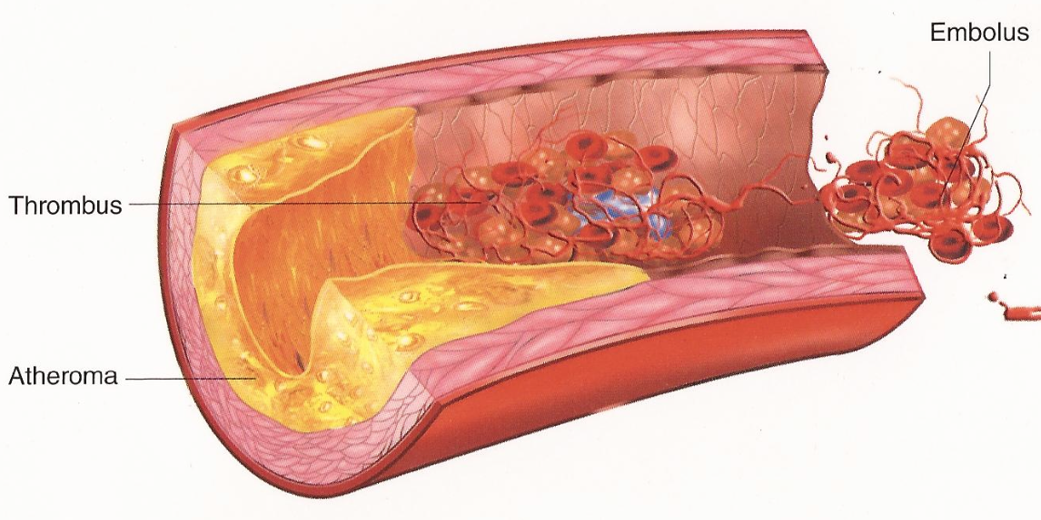
Atheroscleroris is common main cause of cardiovascular diseases
Plaque
Plaques arise from chronic inflammatory response of white blood cells in artery walls

Slide 3
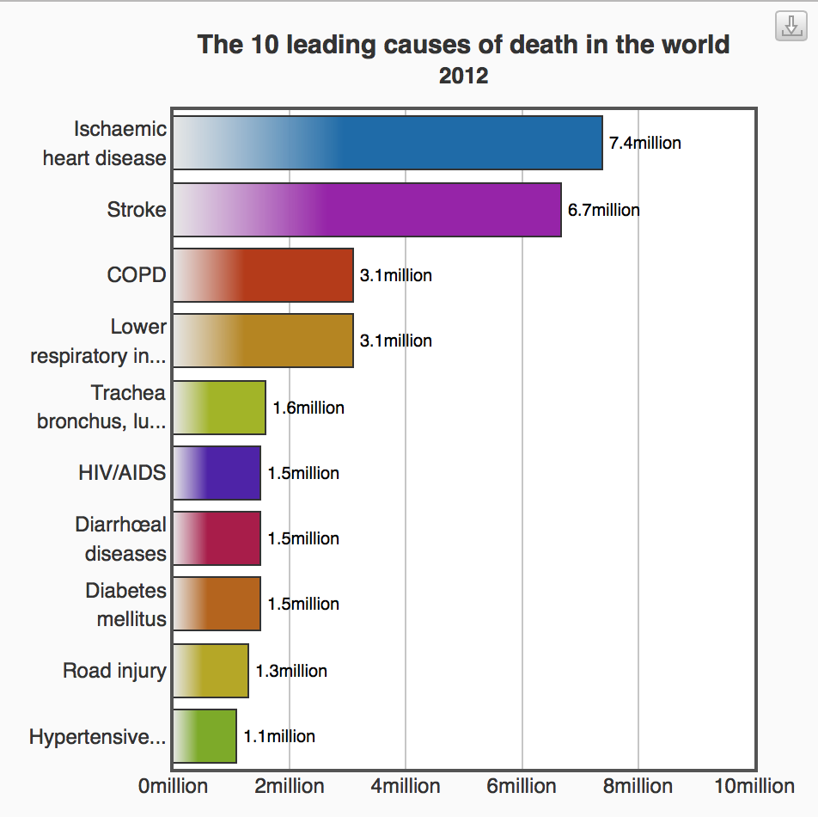
Cardiovascular diseases responsible for 31% of all human deaths (in 2012)
Global deaths by cause
CVD
Source: WHO
CVD No.1 cause of death
CVD No. 3 cause of global disability-adjusted life years lost (after infectious and neuropsychiatric diseases)

Slide 4
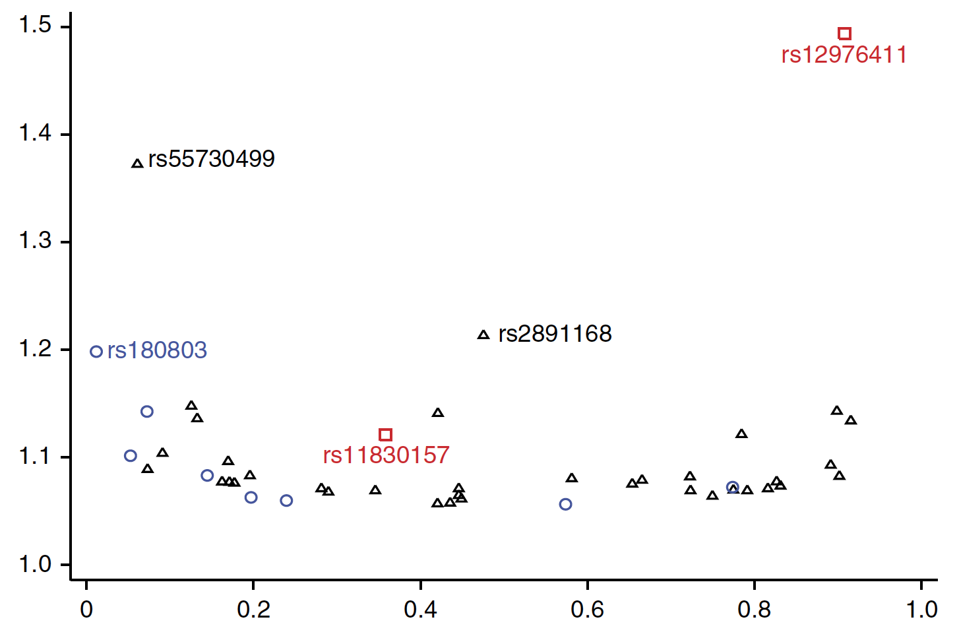
GWAS have discovered many new loci... but so far fewer new mechamisms than hoped for
CAD GWAS identified ~54 statistically significant risk loci in unbiased way! ⁽¹⁾
Odds Ratio (OR)
Effect Allele Frequency
But: we need new mechanisms!
~30% of loci linked to LDL/HDL metabolism or high blood pressure
PCKS7 found in GWAS is targeted by 2 phase-III drugs
Most others cannot be linked to plausible genes or mechanisms
E.g. strongest CVD locus (9p21.3) with OR 1.5(!) still mysterious⁽²⁾
Why?
⁽¹⁾ CARDIoGRAMplusC4D Consortium, Nature Genetics (2015),
⁽²⁾ Hannou et al., Trends in Endocrin. & Metabolism (2015); Swerdlow et al., Curr. Cardiol. Rep. (2015)

Slide 5
Most causal (truly associated) SNPs have regulatory effect
Previously: look for coding SNPs in strong LD to lead SNP ⇒ affected gene
But: „The majority (~93%) of disease-/trait-associated variants lie within noncoding sequence“ (Maurano et al., Science, 2012)
“90% of causal variants are non-coding” (Farh et al., Nature 2015)
Deep exome genotyping and sequencing yielded disappointing results (Peloso et al., AJHG 2014; Do et al, Nature 2015)
These regulatory SNPs influence expression of target genes by disrupting transcription factor binding sites
?
?
SNP

Slide 6
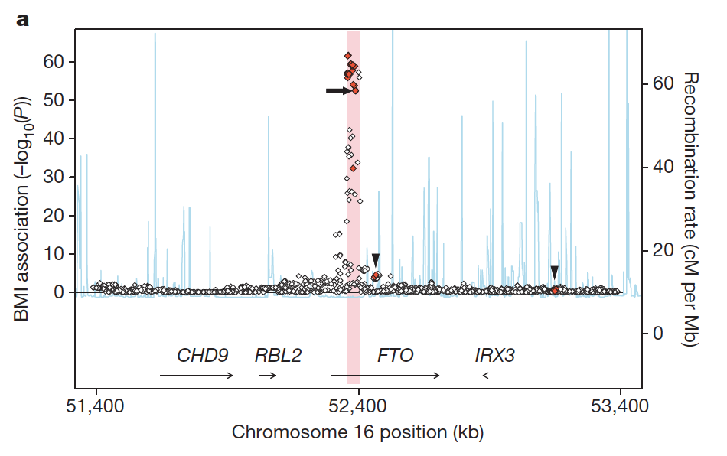
Many regulatory GWAS SNPs may not target the nearest gene
Example: FTO / IRX3 regulation at 500 Mbp: 11 out of 40 eQTLs of IRX3 (red) but none of FTO associated with BMI (Smemo et al, Nature 2014)
Maurano et al, Science 2012: „79% represent [enhancer-gene] pairings with distant promoters versus those of the nearest gene.“
Andersson et al. (Nature 2014) inferred target genes of enhancers based on correlation of gene and enhancer RNAs; 60% of inferred target genes were not the nearest genes

Slide 7
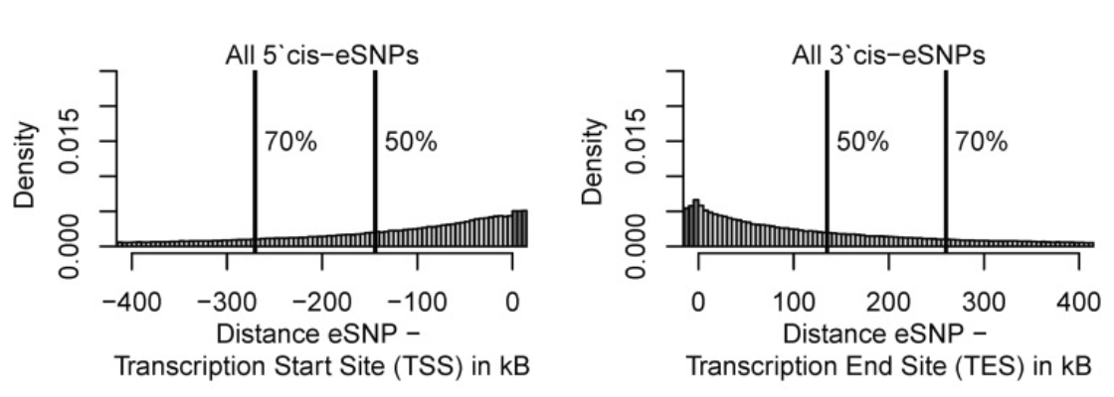
Many regulatory GWAS SNPs may not target the nearest gene
Distance of eSNP to nearest TSS or TES
From eQTL study in peripheral blood mononuclear cells of 2112 individuals
Kirsten et al., Human Mol. Genet. (2015)

Slide 8
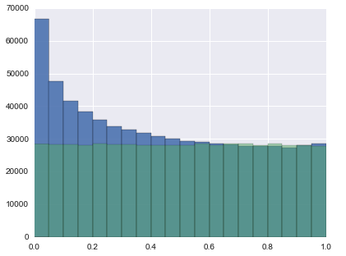
Predict targets of regulatory SNPs from corre-lation of DNA accesiblity and gene expression
chrom. A
corr?
chrom. A
corr?
corr?
corr?
corr?
corr?
chrom. B
corr?
enh
enh
gene
enh
enh
correlation coeff.
TP + FP (true + false pos.)
FP
(false pos.)
TP
FP
-1.0
corr. coeff.
1.0
TP
FP
See poster P-III-6 by Christian Roth
0.0
corr. p-value
1.0

Slide 9
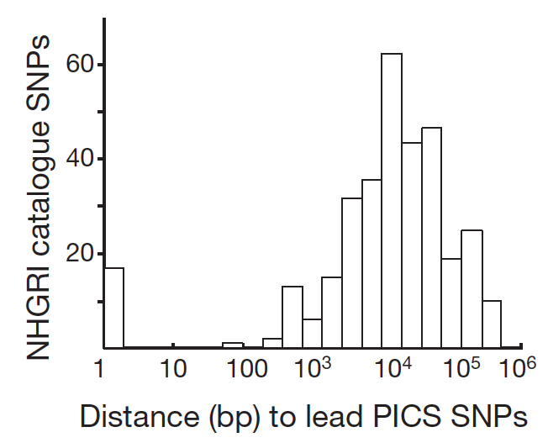
How reliably are causal SNPs predicted so far?
Farh et al., Genetic and epigenetic fine mapping of causal autoimmune disease variants, Nature (2015):
„... index SNPs reported in the GWAS catalogue have on average only a 5% chance of representing a causal SNP. Rather, GWAS catalogue index SNPs are typically some distance from the [most likely causal] PICS lead SNP (median 14 kb), and many are not in tight LD.“

Slide 10
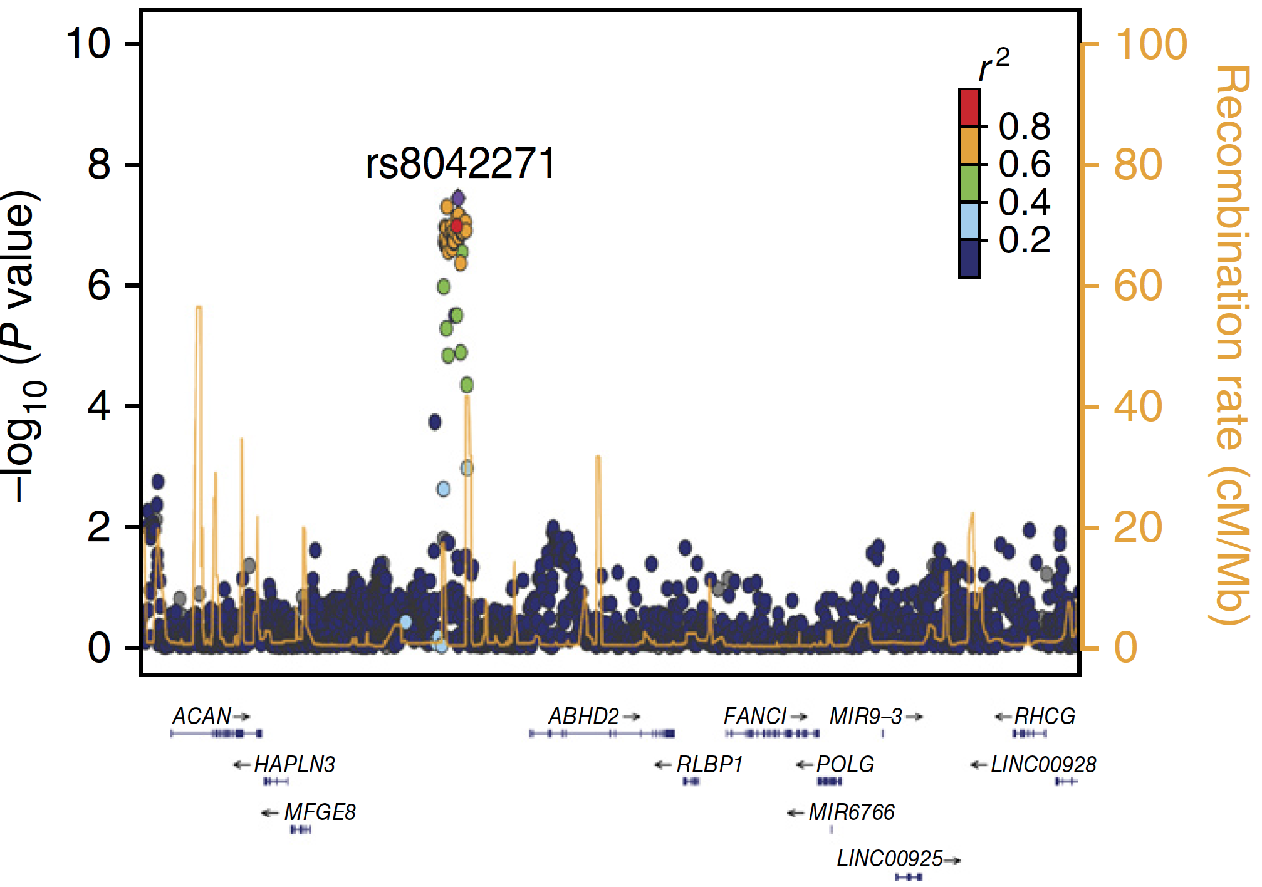
Genetic linkage: most significant SNPs not causal
independent!
CARDIoGRAMplusC4D Consortium, Nature Genetics (2015)

Slide 11
Bayesian models can be very powerful...
in identifying new risk loci with available data
in identifying truly associated SNPs within loci
in identifying new risk loci with available data
in identifying truly associated SNPs within loci
in identifying target genes of regulatory GWAS SNPs
in identifying gene networks whose dysregulation is truly associated with disease risk
in identifying target genes of regulatory GWAS SNPs
in identifying gene networks whose dysregulation is truly associated with disease risk
Why?
They are flexible: treat all SNPs jointly, integrate info such as chromatin profiles, include gene-environment interactions,…
They can learn parameters of models from the data (cool)
They avoid error-laden point estimates of effect strengths. They integrate out effect strengths (cool!)
But?
Integrals often not exactly solvable, need MCMC sampling ⇒ challenging to implement well and slow to run & train

Slide 12
Logistic regression is a popular approach for identifying associated SNPs
effect of SNP i on disease risk
Phenotype of patient n: case φ_{n} =1
control φ_{n} = 0
effect of SNP i = log OR_{i}
logistic function
# minor alleles of SNP i in patient n
p(ϕ_{n} = 1 |x_{ni,} v_{o},v_{i}) = lf(v_{o}+v_{i} x_{ni})
p(ϕ_{n} = 0 |x_{ni,} v_{o},v_{i}) = 1-lf(v_{o}+v_{i} x_{ni})
1
Likelihood
Wald significance test:
Is data compatible with null hypothesis?

Slide 13
Classical hypothesis tests: Is data compatible with null hypothesis?
Null-hypothesis (no effect)
Likelihood
effect strength
σ²_{Lik}

Slide 14
Bayesian logistic regression looks at both null hypothesis and alternative...
... and evaluates the probabilities for both
prior prob. for non-causal δ (v_{i})
prior prob. for causal
N(v_{i}|0,σ_{i}²)
Likelihood
effect strength

Slide 15
Bayesian logistic regression looks at both null hypothesis and alternative...
Bayes’ theorem
genotypes at SNP i of N patients
effect of SNP i on disease risk
Prob. for alternative:
δ(v_{i})
N(v_{i} | 0,σ_{i}²)
N(v_{i}|0,σ_{i}²)
Likelihood
Prior prob.
Prob. for null hypothesis:
δ(v_{i})

Slide 16
We make the prior probability for causality and the width σ_{i} depend on external info ξ_{if}
Prior distribution:
δ (v_{i})
p(v_{i}| π_{i}, σ_{i}) = (1 − π_{i} ) δ (v_{i}) + π_{i} N(v_{i}|0,σ_{i}²)
prior prob. for causality
expected effect size
N(v_{i}|0,σ_{i}²)
Dependence of parameters on external information ξ_{if} :
Hyperparameters β_{f}, γ_{f} can be learnt from the data!

Slide 17
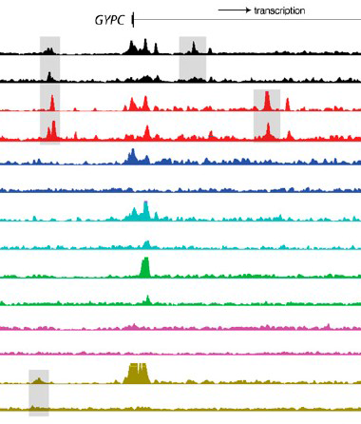
We can make prior prob. for causality π_{i} and width σ_{i} depend on external info ξ_{if}
ξ_{if}
ξ_{i+1,f}
External features ξ_{if} (from ENCODE, Roadmap Epigenomics Project, ...)
chromatin state (1-9)
DNA accessibility in 100s of tissues
Enhancer predictions in 100s of tissues
Predicted impact of SNP on DNA accessibility etc.
Methylation state in 100s of tissues
Minor allele frequency
…
f
Learn sparse dependence of π_{i} and σ_{i} from the data!

Slide 18

Myth: P-value-based hypothesis test makes no assumptions about alternative hypothesis in contrast to Bayesian approaches
δ(v_{i})
If we set the width of the Gaussian component for the causal SNPs to
N(v_{i}|0,σ_{Lik}²)
i.e. the estimation error for v_{i}^{max} in the maximization of the likelihood, then the Bayesian model produces exactly the same ranking as P-values (Jon Wakefield, Genetic Epidem. 2009)
⇒ Hypothesis tests make implicit assumptions about prior distribution
⇒ We can improve upon this by choosing better prior distributions
In our case of logistic regression the width of the (implicit)
Gaussian prior depends on number of patients N.

Slide 19
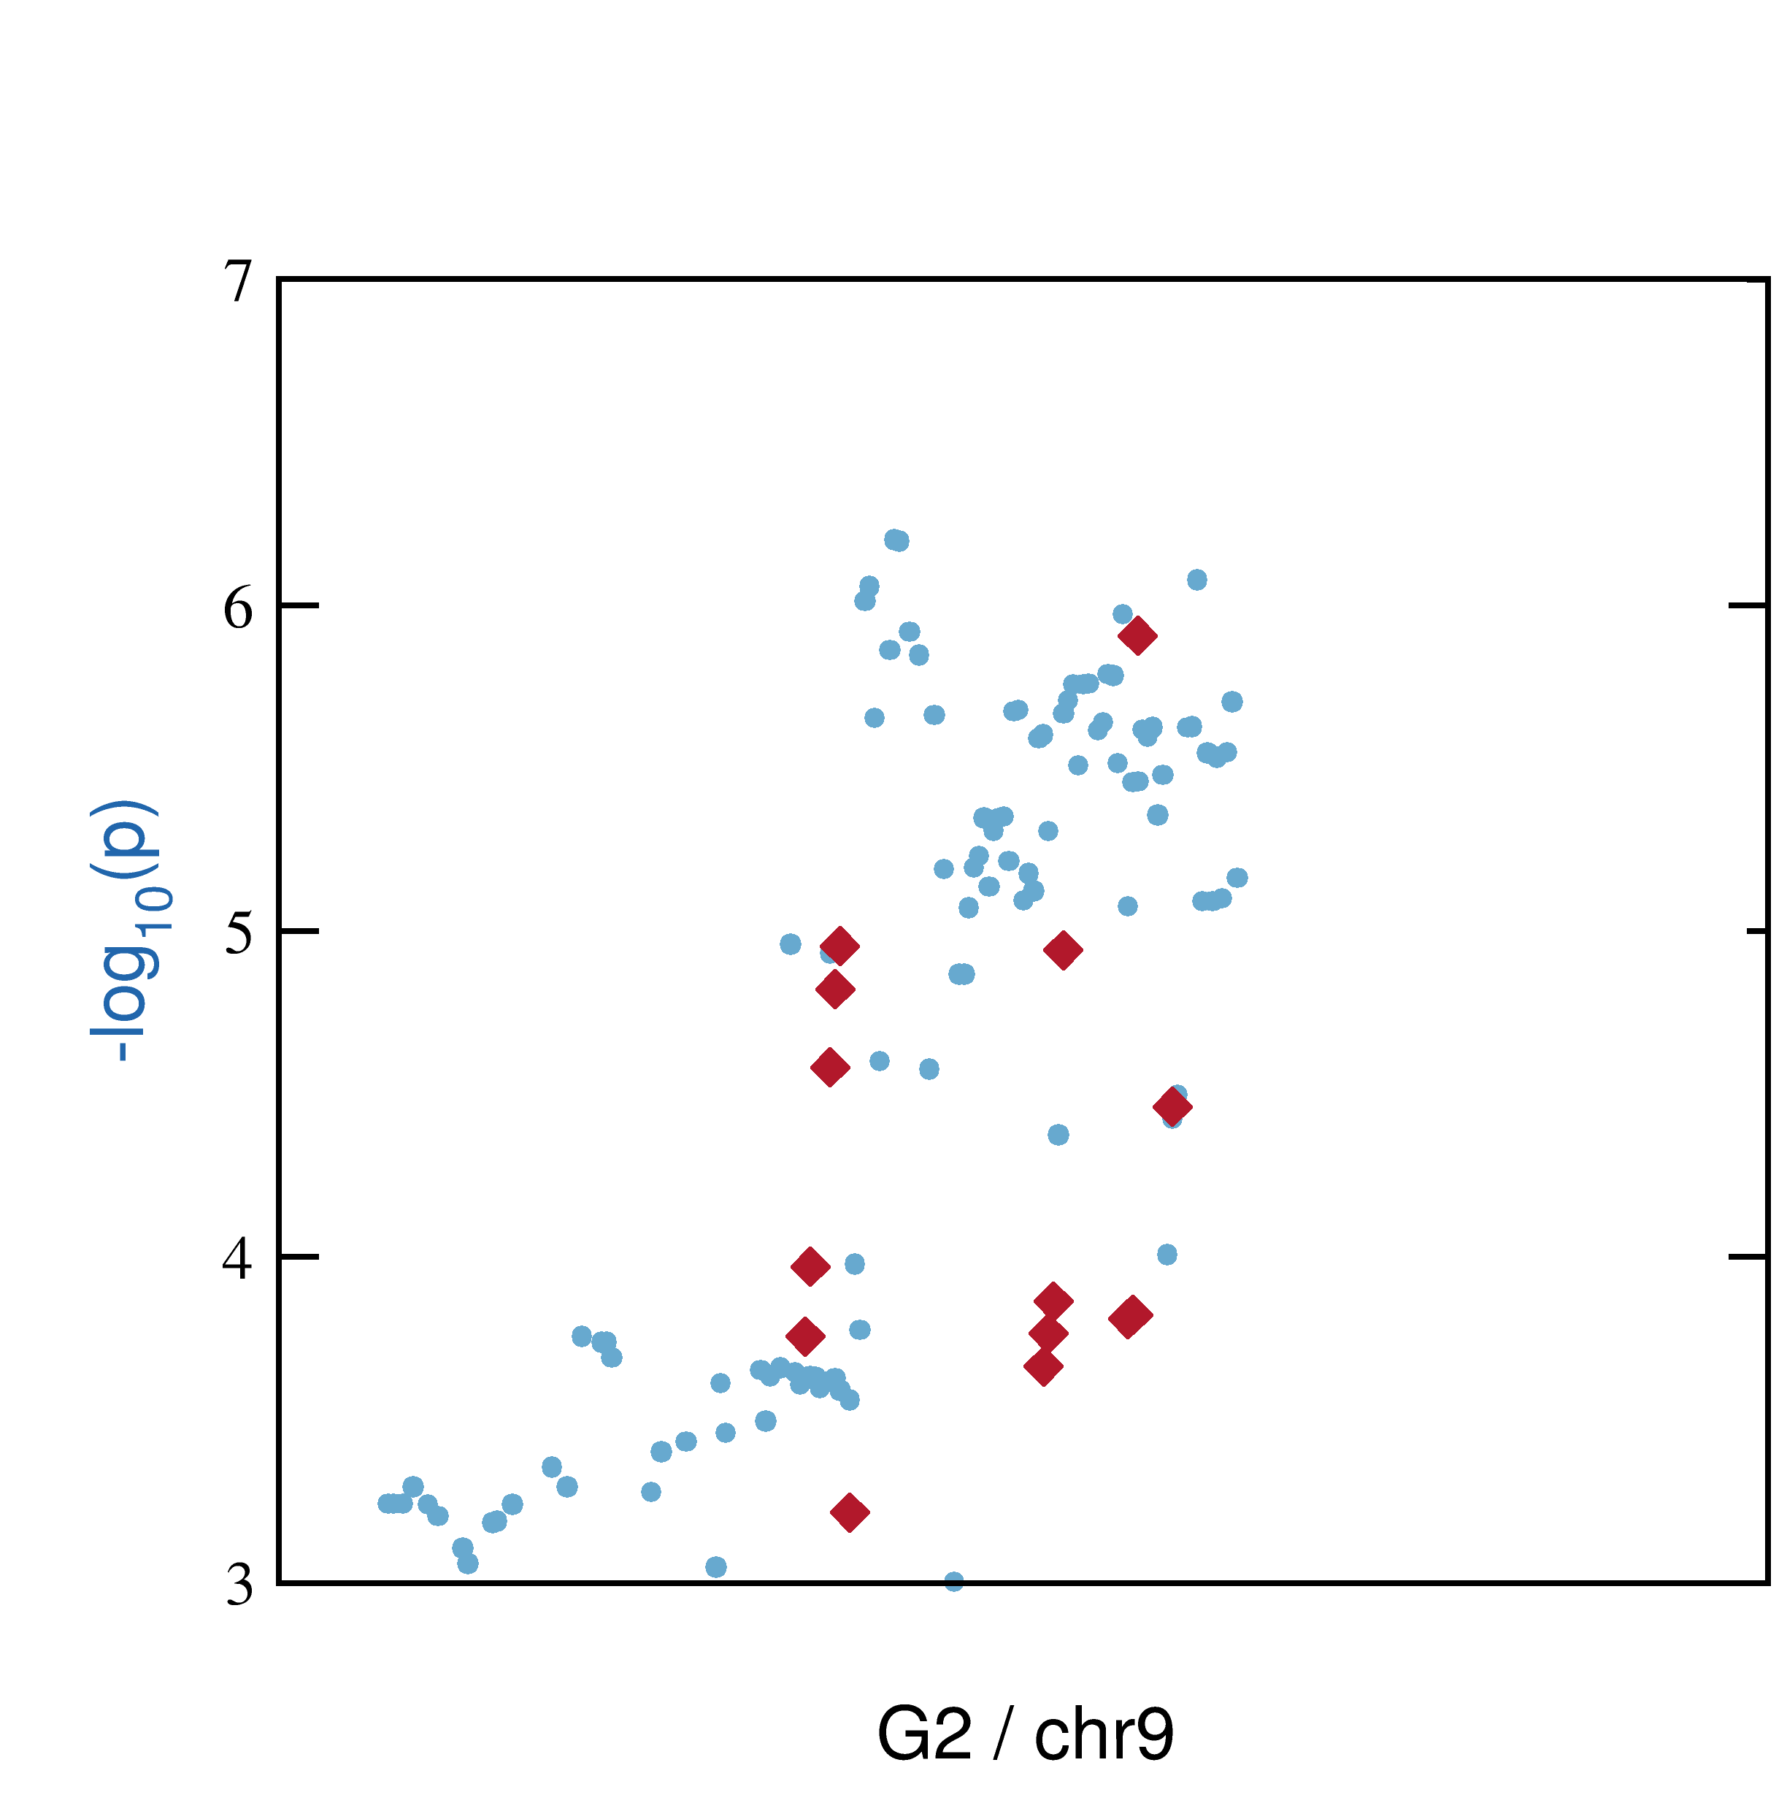
Joint treatment of SNPs automatically takes account of linkage structure
independent SNPs
joint analysis of SNPs
1
Most SNPs are only associated with disease through linkage with causal SNP. Their association will be “explained away.

Slide 20
How to learn hyperparameters ?
Avoid point estimates of parameters v_{i} because they can only be estimated very unreliably
⇒ integrate out parameters v = (v₀ ,v₁,…,v_{i} ,…) !
⇒ maximize the marginal likelihood:
no dependence on effect sizes v
Integral over v usually by MCMC sampling. Very inefficient.
We found analytical approximation (iterative Laplace approx.) ⇒ can efficiently optimize marginal likelihood
Bayesian approach allows us to learn hyperparameters even though we have no reliable point estimates for any of the v_{i}‘s

Slide 21
Bayesian meta-analysis without genotype-level information
Marginal likelihood for single GWAS:
Likelihood
Marginal likelihood for meta-analysis with several GWAS:
product of likelihoods over all studies
Approximate likelihoods with few parameters (~10⁶ per study)
⇒ no genotype information needed

Slide 22
Gene-environment interactions
product of SNP features and environment variables
effect sizes of interactions
Increases number of v-parameters 3-fold
⇒ unproblematic
Works the same for interactions between SNPs and principle components describing population substructure.
⇒ What SNPs have effect in particular population?

Slide 23
Recap: In Bayesian approach we integrate over all possible effect sizes for causality
... instead of using point estimates of effect sizes as in classical statistics
This avoids systematic errors due to large, correlated errors on point estimates when
learning hyperparameters,
computing posterior probabilities,
estimating disease risk.
non-causal
causal
Likelihood
integrate over all effect sizes
effect size

Slide 24
Advantages of our Bayesian approach for predicting causal SNPs
Joint modeling of all SNPs “explains away” most associations
Include information from ENCODE, Roadmap Epigenomics,...
Learn hyperparameters for dependencies from data
Include gene-environment interactions easily
Avoid multiple-testing problem
Predict genetic risk by integrating out difficult-to-estimate v’s
Next Steps:
Test method’s ability to rank loci and SNPs within loci
Develop Bayesian model to predict gene networks whose dysregulation explains disease risk

Slide 25


Many thanks to:
Christian Roth
Saikat Banerjee
Hiwi / bachelor student on e:AtheroSysMed since 10/2013
Postdoc on e:AtheroSysMed since 06/2015

Slide 26
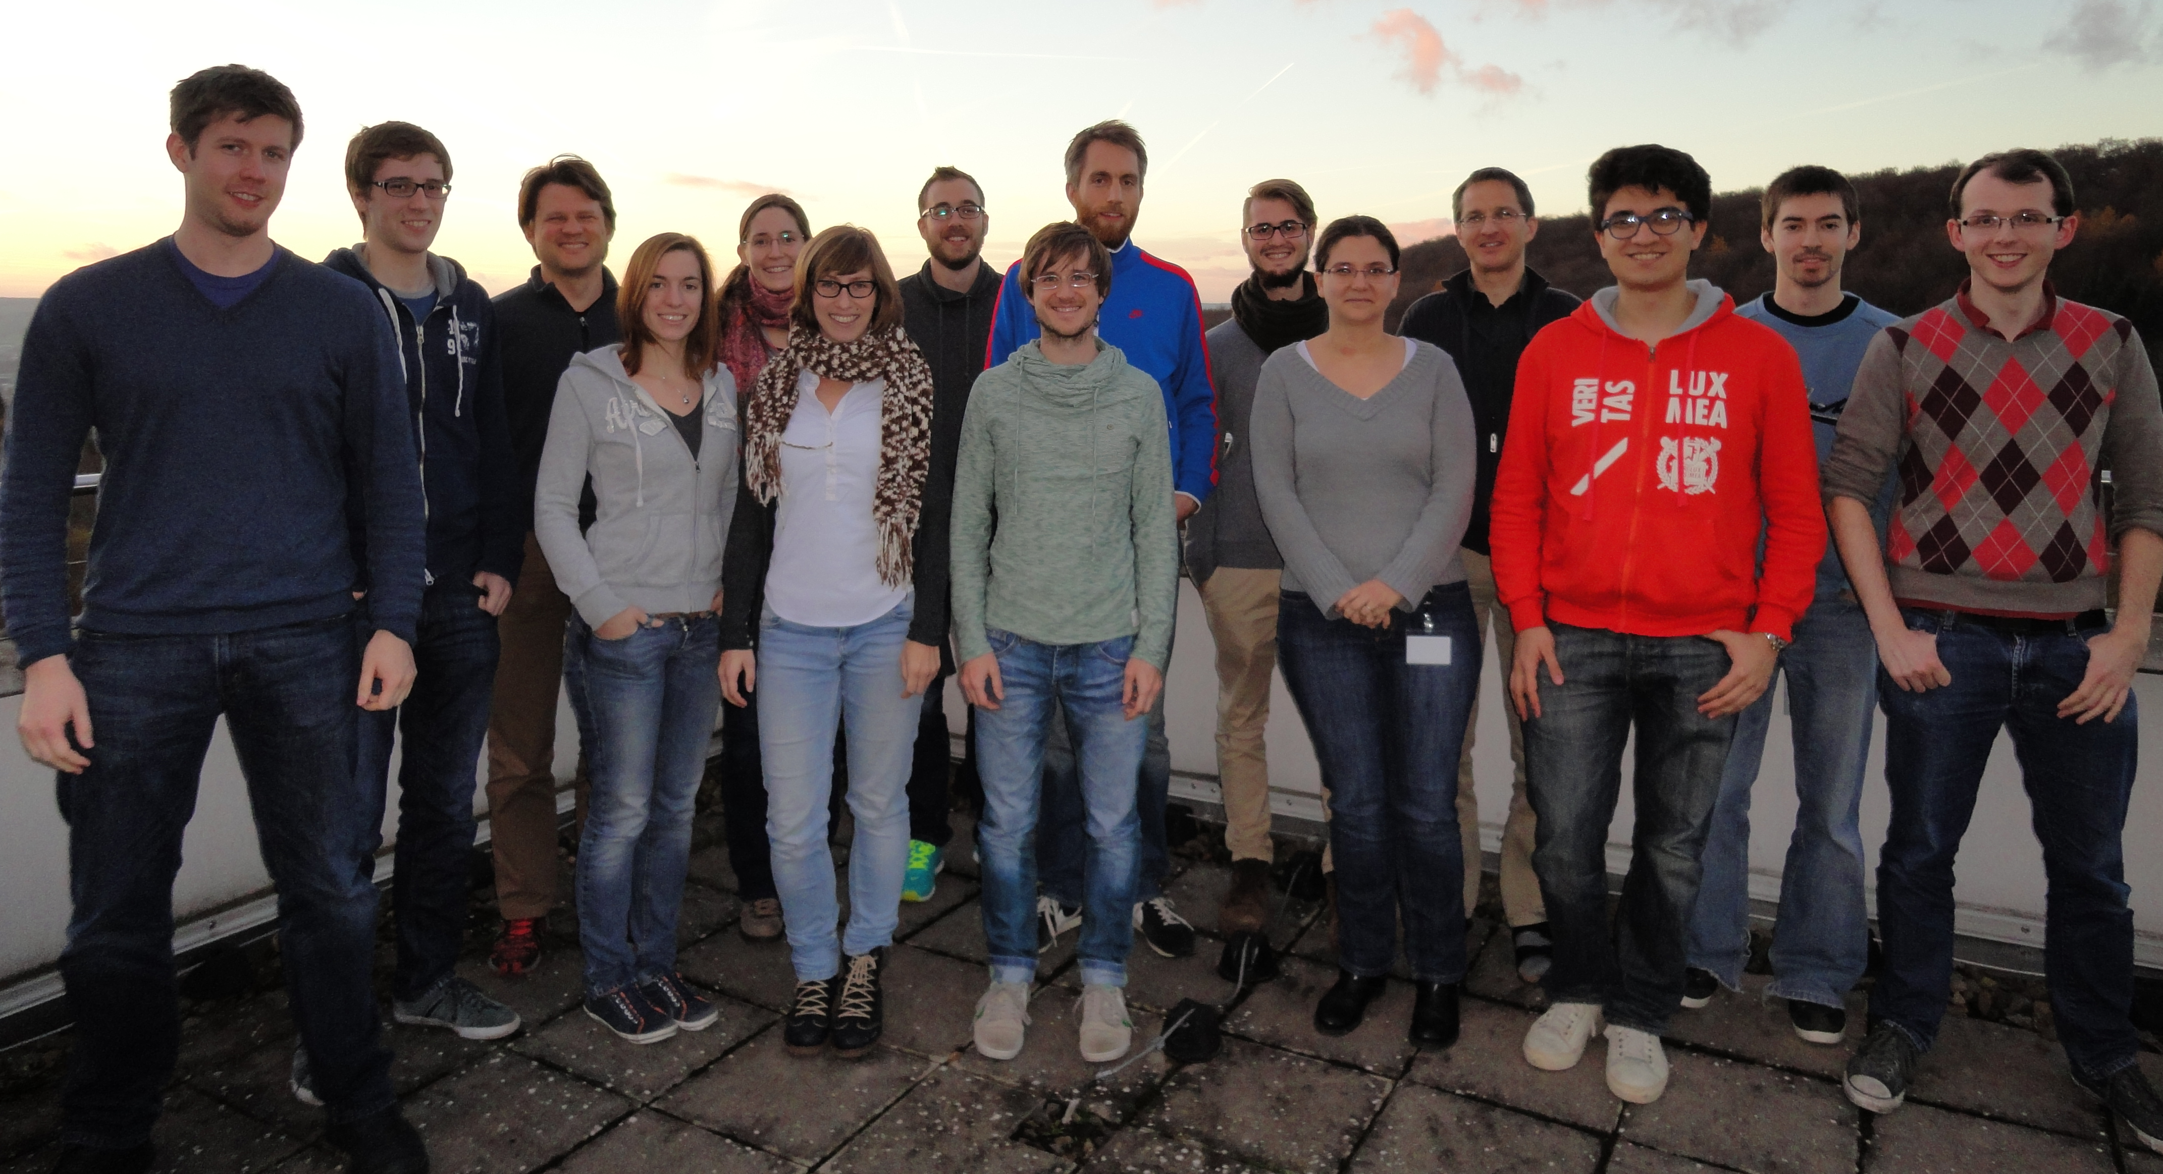
Thanks to
the Söding Lab

Slide 27


Thank you!
Mastertitelformat bearbeiten

Slide 28
eQTL studies have potential to link GWAS SNPs with target genes
GTEx project is a massive eQTL study
dbGaP Release Date | Genotype Data | Sequence Data
 | Total # Subjects - SNP Chip | Total # Subjects with Gene Expression | Total # RNA Seq experiments after QC/Filtering
June 12, 2012 | 63 | 56 | -
Nov 20, 2012 | 94 | 73 | -
April 10, 2013 | 185 | 178 | 1641
April 04, 2014 | 185 | 212 | 2921
est June, 2015 | 185 | 550 | 7349
est Oct 2015 | 451 | 550 | TBD
Approx mid 2016 | ~900
Results in publication from May 2015 are disappointing.
Better analysis methods and more data are needed!

Slide 29
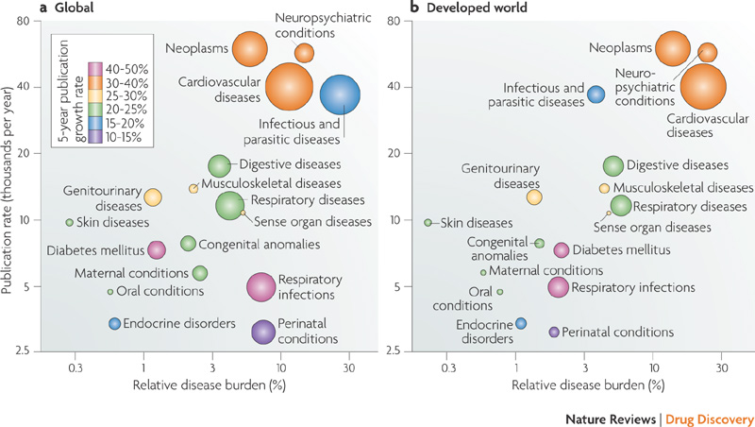
Cardiovascular diseases No.3 cause of life years lost
Source: WHO, 2012 statistics
Relative disease burden = fraction of disability-adjusted life years lost
bubble volume ∝ #deaths

Slide 30
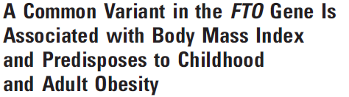
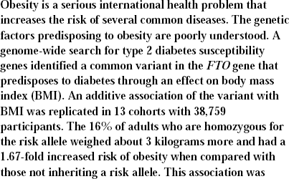
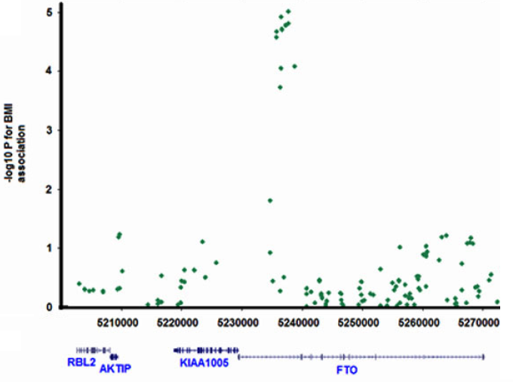
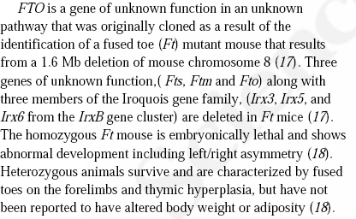
region with mutations that increase obesity risk
SNPs
-log₁₀ P for BMI association
…

Slide 31
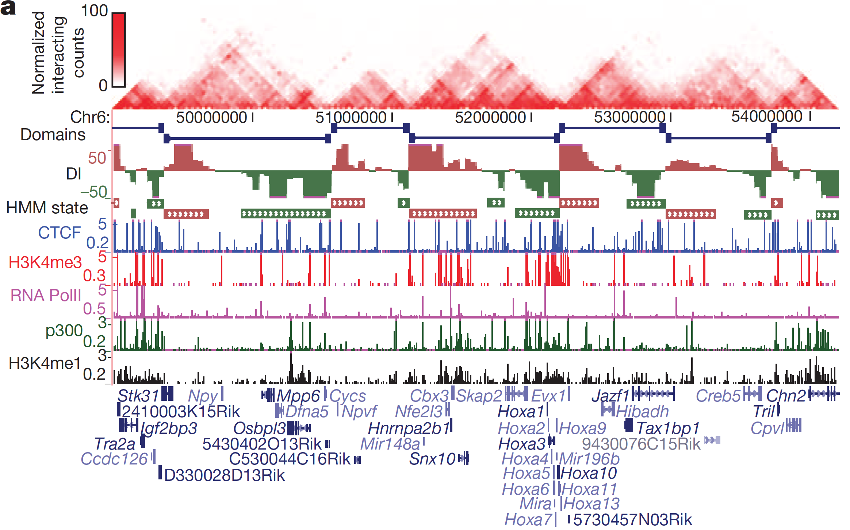
HiC measures DNA-DNA contacts genome-wide (resolution ~50kbp, only very few cell types available)
Topological domains
Dixon. et al. Nature (2012).

